Slide 1

REST Web Service-Rest Assured
11/16/2021

Slide 2
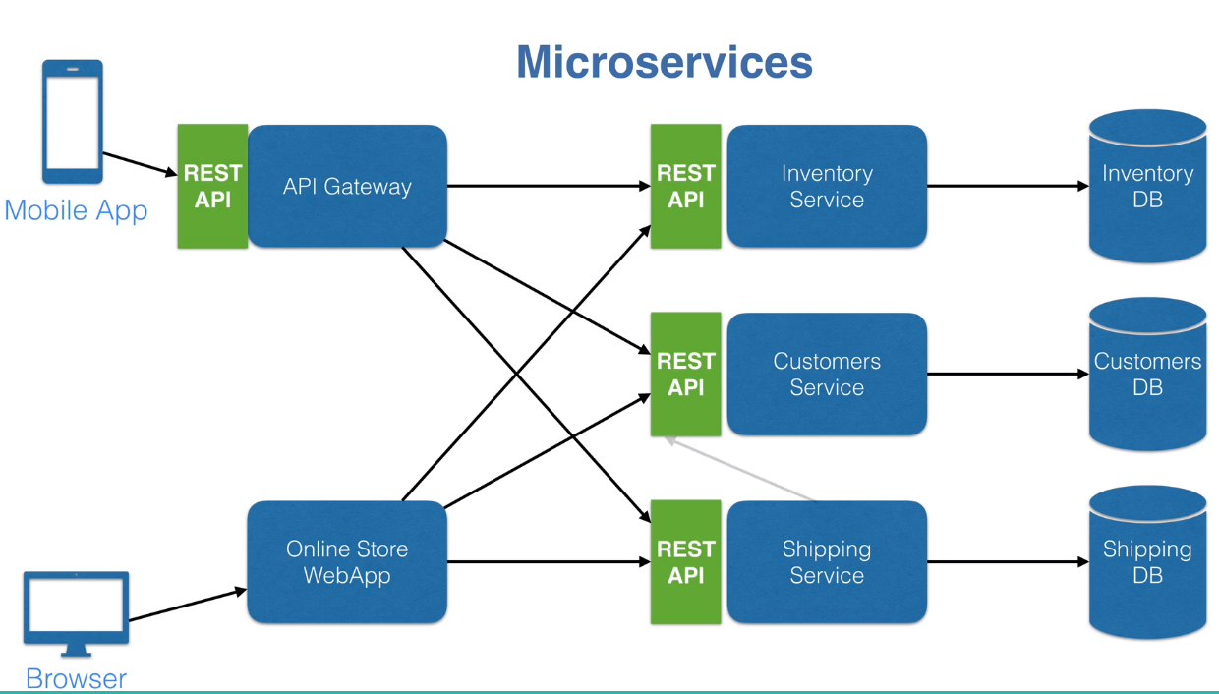
What is Microservices?
Notes:
In simplest words, in the REST architectural style, data and functionality are considered resources and are accessed using Uniform Resource Identifiers (URIs). The resources are acted upon by using a set of simple, well-defined operations. The clients and servers exchange representations of resources by using a standardized interface and protocol – typically HTTP.
Resources are decoupled from their representation so that their content can be accessed in a variety of formats, such as HTML, XML, plain text, PDF, JPEG, JSON, and others. Metadata about the resource is available and used, for example, to control caching, detect transmission errors, negotiate the appropriate representation format, and perform authentication or access control.And most importantly, every interaction with a resource is stateless.
All these principles help RESTful applications to be simple, lightweight, and fast.

Slide 3
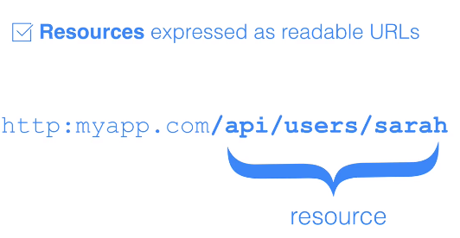
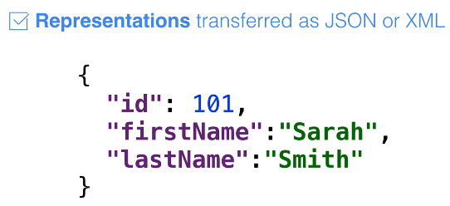


What is REST?
REST stands for Representational State Transfer.
Basic principle of rest

Slide 4
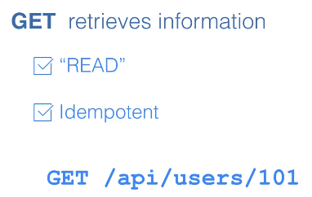
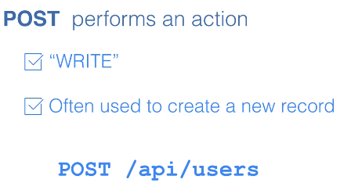
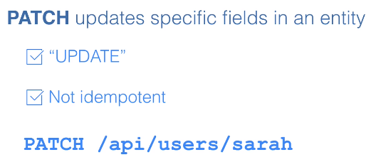
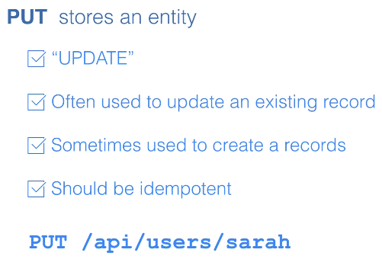

Rest Methods

Slide 5
Rest STATUS Codes
HTTP Verb | CRUD | Response
POST | Create | 201 (Created), 409 (Conflict) if resource already exists...
GET | Read | 200 (OK), 404 (Not Found), if ID not found or invalid.
PUT | Update/Replace | 200 (OK) or 204 (No Content). 404 (Not Found), if ID not found or invalid.
PATCH | Update/Modify | 200 (OK) or 204 (No Content). 404 (Not Found), if ID not found or invalid.
DELETE | Delete | 200 (OK). 404 (Not Found), if ID not found or invalid.

Slide 6
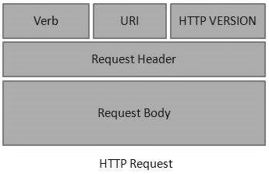
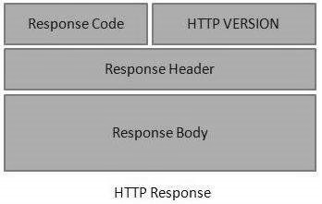
RESTful Web Services - Messages
RESTful Web Services make use of HTTP protocols as a medium of communication between client and server. A client sends a message in form of a HTTP Request and the server responds in the form of an HTTP Response.
An HTTP Request has five major parts −
Verb − Indicates the HTTP methods such as GET, POST, DELETE, PUT, etc.
URI − Uniform Resource Identifier (URI) to identify the resource on the server.
HTTP Version − Indicates the HTTP version. For example, HTTP v1.1.
Request Header − Contains metadata for the HTTP Request message as key-value pairs. For example, client (or browser) type, format supported by the client, format of the message body, cache settings, etc.
Request Body − Message content or Resource representation.
An HTTP Response has four major parts −
Status/Response Code − Indicates the Server status for the requested resource. For example, 404 means resource not found and 200 means response is ok.
HTTP Version − Indicates the HTTP version. For example HTTP v1.1.
Response Header − Contains metadata for the HTTP Response message as keyvalue pairs. For example, content length, content type, response date, server type, etc.
Response Body − Response message content or Resource representation.

Slide 7
REST APIs parameters:
Query parameters: These are appended at the end of a RESTful API endpoint and can be identified by the question mark in front of them. For example, in the endpoint http://md5.jsontest.com/?text=test, "text" is a query parameter (with value "test").
http://md5.jsontest.com/?text=testcaseOne
http://md5.jsontest.com/?text=testcaseTwo
Path parameters: These are part of the RESTful API endpoint. For example, in the endpoint we used earlier: http://ergast.com/api/f1/2017/circuits.json, "2017" is a path parameter value.
http://api.zippopotam.us/us/90210
http://api.zippopotam.us/ca/B2A

Slide 8
REST Assured
REST Assured is a Java DSL for simplifying testing of REST based services built on top of HTTP Client.
It supports POST, GET, PUT, DELETE, OPTIONS, PATCH and HEAD requests and can be used to validate and verify the response of these requests.
REST Assured can be used to test XML as well as JSON based web services.
REST Assured can be integrated with JUnit and TestNG frameworks for writing test cases for our application. It also supports BBD/Gherkin
REST assured is the support of XML Path and JSON Path syntax to check specific elements of the response data.

Slide 9
About Hamcrest matchers
Express expectations in natural language
http://hamcrest.org/JavaHamcrest/javadoc/1.3/org/hamcrest/Matchers.html
Examples:
equalTo(X) | Does the object equal X?
hasItem(“Rome”) | Does the collection contain an item “Rome”?
hasSize(3) | Does the size of the collection equal 3?
not(equalTo(X)) | Inverts matcher equalTo()
Notes:
Go into a little more detail with regards to Hamcrest matchers – readable matchers for creating checks
9

Slide 10
Code Walkthrough
Get
Post
Delete
JSON Parsing
XML Parsing
E2E flow
Update
Project Setup-Maven

Slide 11
Specifying Request Data
HTTP resources
when().get("/x"). ..;
Parameters
given().param("param1", "value1").param("param2", "value2").when().get("/something");
Multi-value parameter
List<String> values = new ArrayList<String>(); values.add("value1"); values.add("value2");
given().param("myList", values). ..
Path parameters
post("/reserve/{hotelId}/{roomNumber}", "My Hotel", 23);
Cookies
given().cookie("username", "John").when().get("/cookie").then().body(equalTo("username"));
Headers
given().header("MyHeader", "Something").and(). ..
given().headers("MyHeader", "Something", "MyOtherHeader", "SomethingElse").and(). ..
Content Type
given().contentType(ContentType.TEXT). ..
given().contentType("application/json"). ..
Request Body
given().body("some body"). .. // Works for POST, PUT and DELETE requests
given().request().body("some body"). .. // More explicit (optional)

Slide 12
Verifying Response Data
Status
Cookies
get("/x").then().assertThat().cookie("cookieName", "cookieValue"). ..
get("/x").then().assertThat().cookies("cookieName1", "cookieValue1", "cookieName2", "cookieValue2"). ..
Headers
get("/x").then().assertThat().header("headerName", "headerValue"). ..
get("/x").then().assertThat().headers("headerName1", "headerValue1", "headerName2", "headerValue2"). ..
Content Type
get("/x").then().assertThat().contentType(ContentType.JSON). ..
Request Body
get("/x").then().assertThat().body(equalTo("something")). ..
Measuring Response Time
get("/lotto").timeIn(SECONDS);
get("/x").then().assertThat().statusCode(200). ..

Slide 13
Construct Request or Response Specification
You can use the builder to construct a request or response specification.
RequestSpecBuilder:
RequestSpecification spec=new RequestSpecBuilder().setBaseUri("http://api.zippopotam.us").build();
given().spec(spec).when().get("/us/90210").then().statusCode(200);
ResponseSpecBuilder:
ResponseSpecification spec=new ResponseSpecBuilder().expectContentType(ContentType.JSON).expectStatusCode(200).build();
given().when().get("http://api.zippopotam.us/us/90210").then().spec(spec).and().body("country", equalTo("United States"));

Slide 14
About GPath
JsonPath is a query language for JSON documents
REST Assured using the GPath implementation
Similar aims and scope as XPath for XML
Documentation and examples:
http://groovy-lang.org/processing-xml.html#_gpath
http://groovy.jmiguel.eu/groovy.codehaus.org/GPath.html
Notes:
Go into a little more detail with regards to Gpath for effective selection of elements from XML and JSON responses
14

Slide 15
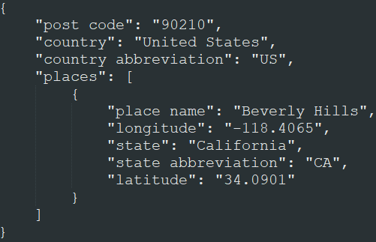
GPath example
body(“places[0].’place name’”, equalTo(“Beverly Hills”));
Notes:
Go into a little more detail with regards to Gpath for effective selection of elements from XML and JSON responses
15

Slide 16
SSL-Secure Sockets Layer
SSL, or Secure Sockets Layer, is an encryption-based Internet security protocol
javax.net.ssl.SSLHandshakeException: sun.security.validator.ValidatorException:
PKIX path building failed: sun.security.provider.certpath.SunCertPathBuilderException:
unable to find valid certification path to requested target
String response =
given().get("https://jsonplaceholder.typicode.com/photos/1")
.then()
.contentType(ContentType.JSON)
.body("albumId",equalTo(1))
.extract()
.path("url");
given().relaxedHTTPSValidation().get(response).then().statusCode(200);
}

Slide 17
serialization of POJOs
REST Assured is able to convert POJO instances directly to XML or JSON (and back)
Useful when dealing with test data objects
Requires additional libraries on the classpath
Jackson or Gson for JSON
JAXB for XML

Slide 18
AUTHENTICATION
REST assured also supports several authentication schemes, for example Basic, OAuth, digest, certificate etc.
There are two types of basic authentication -preemptive and challenged.
Preemptive Basic Authentication: This will send the basic authentication credential even before the server gives an unauthorized response in certain situations, thus reducing the overhead of making an additional connection.
given().auth().preemptive().basic("username", "password").when().get("/secured/hello").then().statusCode(200);
Challenged Basic Authentication :When using "challenged basic authentication" REST Assured will not supply the credentials unless the server has explicitly asked for it. This means that REST Assured will make an additional request to the server
given().auth().basic("username", "password").when().get("/secured/hello").then().statusCode(200)
Oauth2 Authentication
given().auth().oauth2("myAuthenticationToken").when().get("https://my.very.secure/api").then().assertThat().statusCode(200);

Slide 19
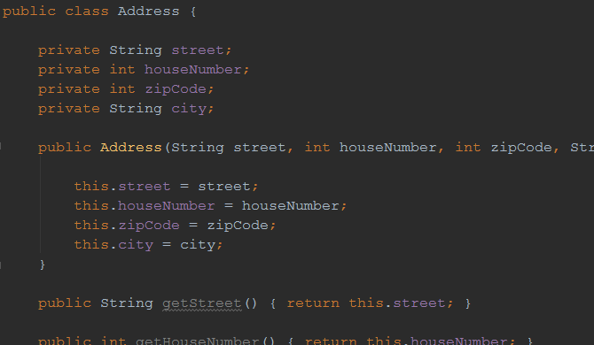
Example: serialization
POJO representing an address

Slide 20
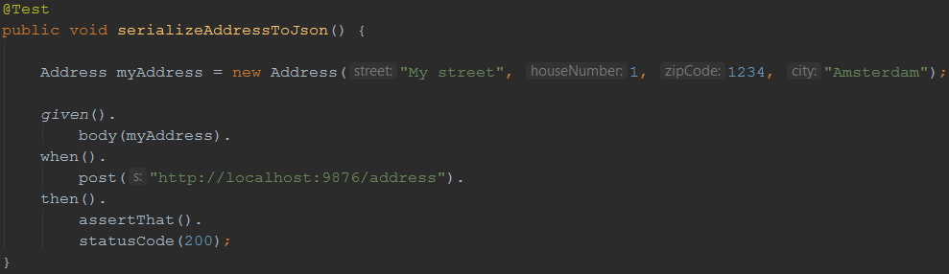
Example: serialization
Instantiating it in a test and sending it as a request body for a POST method:

Slide 21
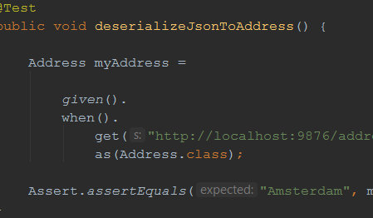
Example: deserialization
We can also convert a JSON (or XML) body back to an instance of a POJO
After that, we can do some verifications on it:

Slide 22
Problem Statement-1
Get:
From url: https://jsonplaceholder.typicode.com/comments
Retrieved the last entry from the response and print the email on console

Slide 23
Problem Statement-2
Post: Post the following request to the URL given below
Endpoint : http://localhost:3000/comments
Post a request:{
“Id”: random number,
“Name”: ”Sumit Ghosh”
“Designation”: “TL”
}

Slide 24
Q&A

Slide 25
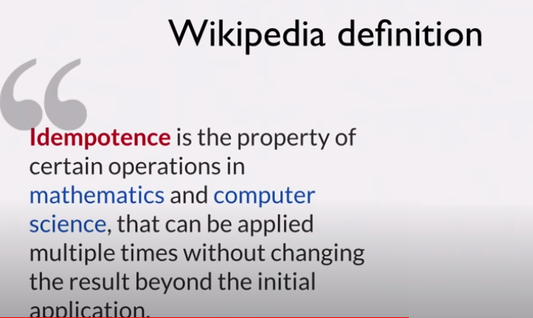
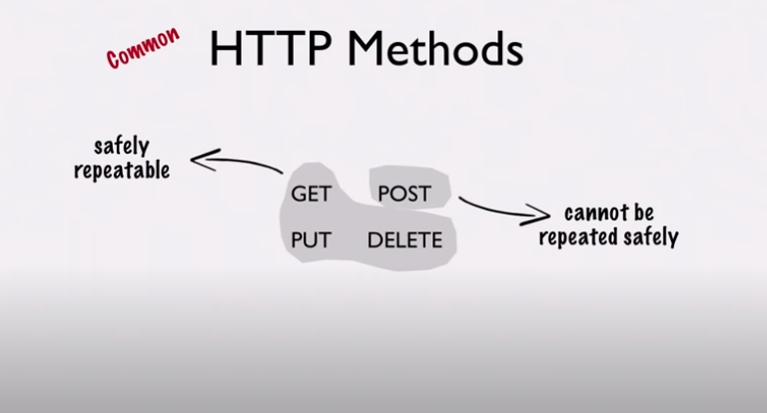
Idempotent

